Slide 1

CAP 6317/4773: Social Media Mining
Lecture 22: Recommendation Engines
Raiyan Abdul Baten, Ph.D.
April 9, 2024

Slide 2
Recap

Slide 3
Recommendation vs Search
The key is personalization
“Best 2024 movie to watch” should give user-tailored results in a Recommendation setting
We’re trying to guess what you might like in the future

Slide 4
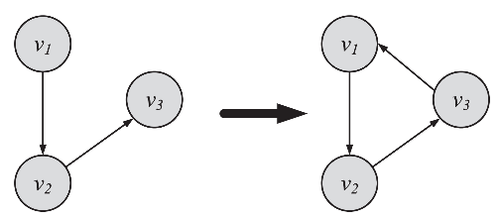
Person Recommendation
Network characteristics are natural choices for making peer recommendations
Transitive Linking: Triadic closure
Close the triangles: Recommend peers with high mutual friend counts

Slide 5
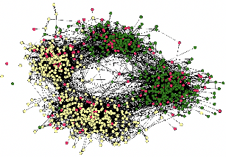
Person Recommendation
Network characteristics are natural choices for making peer recommendations
Assortativity
Now we’re considering node attributes on top of the network structure
Pick the assortativity dimension you care about: Demographic attributes (Facebook)? Career attributes (Linkedin)? Interest attributes (Reddit, Pinterest)?
Recommend peers so that assortativity increases/decreases along the desired dimension

Slide 6
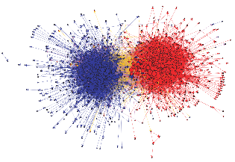
Person Recommendation
Network characteristics are natural choices for making peer recommendations
Community Detection
Find and recommend others in the same community
“Oh I see you’re a football fan, here’s another football fan you can befriend”
Slippery slope: can lead to polarization and extremity
Echo chambers from like-minded people can fuel confirmation bias

Slide 7
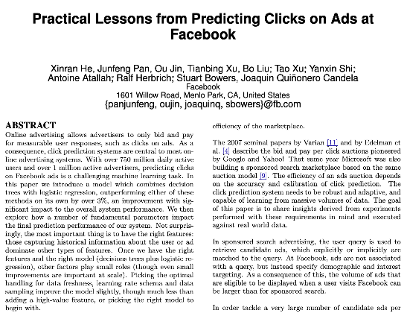
Content Recommendation
Good peer recommendation sustains your platform, good content recommendation makes you money
Optimizing Click-through Rates (CTR) is the money-making no-brainer

Slide 8
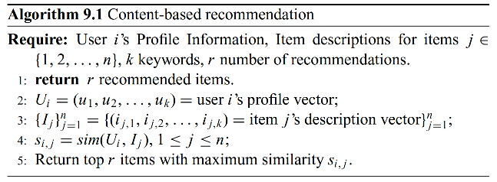
Simple Idea: Cosine Similarity
Represent each user i using an embedding vector, u_{i}
Represent each content j using an embedding vector, c_{j}
Loop over j: Take cosine similarity for every user-content pair: cosine(u_{i}, c_{j})
Return top r contents with the highest similarity to recommend to u_{i}

Slide 9
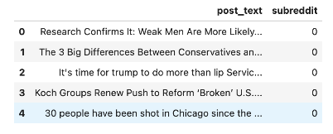
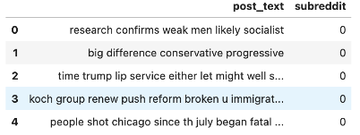
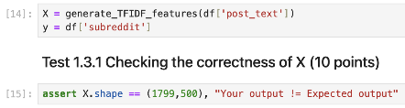

How do you learn the Embedding Vectors?
In the end, we kept 500 dimension vectors (capturing the most prominent 500 words in the corpus) to represent the posts

Slide 10
How do you learn the Embedding Vectors?
Represent each user using an embedding vector, u_{i}
Represent each content using an embedding vector, c_{j}
Take cosine similarity for every user-content pair: cosine(u_{i}, c_{j})
Return top r items with the highest similarity
If you know textual descriptions of the user’s profile (e.g., LinkedIn profile) and the content (e.g., LinkedIn job posting), you can convert the text descriptions into vectors using NLP, and compute cosine similarities of the vectors to make recommendations

Slide 11
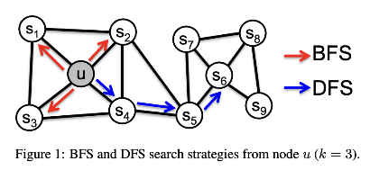

How do you learn the Embedding Vectors?
If you know the social network of users, (or the bipartite network of users and contents), you can generate embedding vectors for each user/content using graph embedding techniques. The Node2Vec method is popular and easy; there are Graph Neural Methods that perform even better

Slide 12
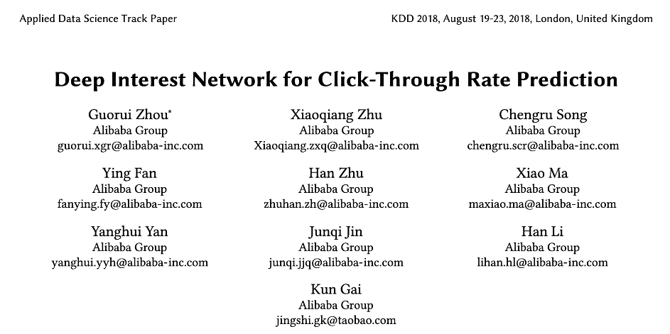
Paper from Alibaba: Let’s try to predict whether a user will click on a content recommendation

Slide 13
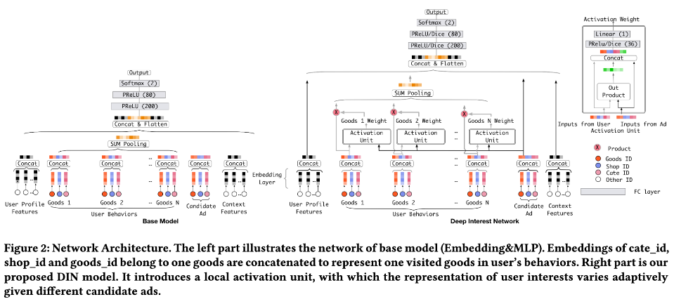
Using all of the features, let us train an end-to-end model that will predict Click Through Rate

Slide 14
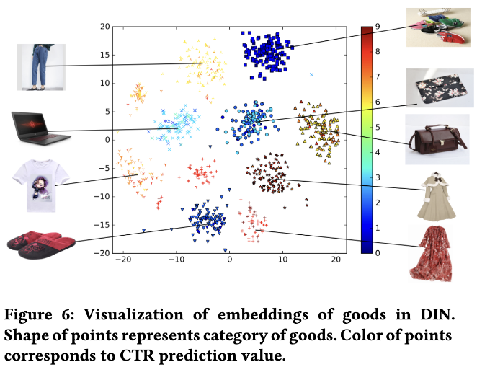
Embedding vectors learned by the model. Clearly, the embedding vectors are meaningful since similar products are clustered together in the vector space. Interestingly, if we predict click through rates using these embedding vectors, we find that click-through rates are more predictable for dresses than shoes!!

Slide 15
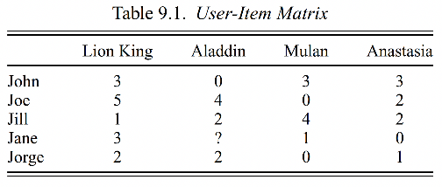

Collaborative Filtering

Slide 16
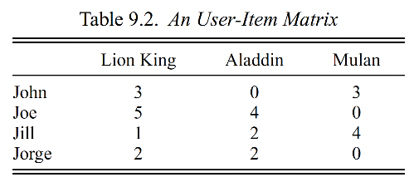

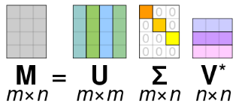
Collaborative Filtering using Singular Value Decomposition (SVD)
The user-item matrix can be extremely large and sparse. Let us find a reduced-sized approximation of the matrix so that we only keep the ‘systematic’ patterns of user-item interaction and get rid of the noise. SVD allows us to achieve that. Using SVD, the user-item matrix is first decomposed into three matrices in a lossless manner (no information is lost yet).

Slide 17
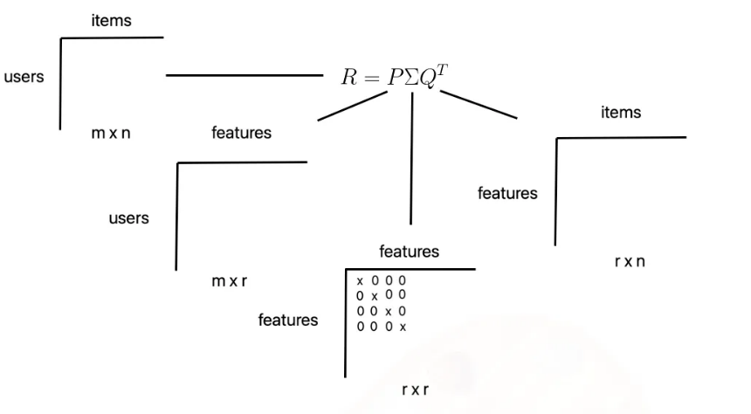
This is our original user-item matrix. We have m users and n items
Stolen from https://medium.com/@corymaklin/model-based-collaborative-filtering-svd-19859c764cee

Slide 18
The first decomposed matrix captures latent representations of the rows (users). The SVD operation will actually generate an mxm matrix, but we will crop the matrix to keep the first r columns (we are losing information now). Each of the m users will then be represented with an r dimensional feature vector in this truncated matrix
Stolen from https://medium.com/@corymaklin/model-based-collaborative-filtering-svd-19859c764cee

Slide 19
The third decomposed matrix captures latent representations of the columns (items). Once again, the SVD operation will create an nxn matrix, but we will crop the matrix to keep the first r rows. Each of the n items will then be represented with a r dimensional feature vector (along the columns) in this matrix
Stolen from https://medium.com/@corymaklin/model-based-collaborative-filtering-svd-19859c764cee

Slide 20
The absolute values in the diagonal matrix Sigma represent how important the associated dimensions are in terms of expressing the original ratings matrix.
Stolen from https://medium.com/@corymaklin/model-based-collaborative-filtering-svd-19859c764cee

Slide 21
If we sort those values in descending order and exclude all but the top r (user defined) features, we can obtain the best approximation of the user-item matrix by multiplying the truncated matrices back together.
Stolen from https://medium.com/@corymaklin/model-based-collaborative-filtering-svd-19859c764cee

Slide 22
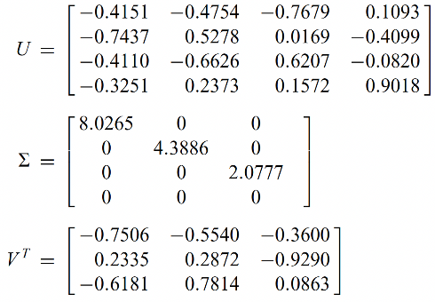
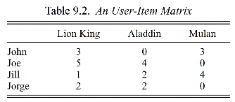
Collaborative Filtering using SVD

Slide 23
Collaborative Filtering using SVD
Original decomposed matrix before truncation. Each of the 4 users has their feature representation along the rows of U

Slide 24
Collaborative Filtering using SVD
Similarly, each of the 3 movies has their untruncated feature representation along the columns of V^{T}

Slide 25
Collaborative Filtering using SVD
Notice how the diagonal values are sorted in a descending order. The absolutes values here denote the importance of each feature dimension. We would like to keep only the most important dimensions

Slide 26
Collaborative Filtering using SVD
Let’s truncate the matrices so that we retain the best two dimensions, i.e., choose r=2. Here, r is the number of latent features we choose. If r is too small, we will lose too much information. If r is too high, we’ll be back to the original sparsity problem
Notes:
Low-rank approximations of matrices remove noise by assuming that the matrix is not generated at random and has an underlying structure.
SVD can help remove noise by computing a low-rank approximation of a matrix

Slide 27
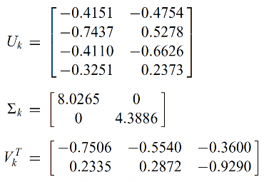
Collaborative Filtering using SVD
Truncated matrices. Multiplying them back together will give us a lower-rank approximation of the original user-item matrix. Running the collaborative filtering algorithm on this reduced matrix will make prediction-generation a lot easier.

Slide 28
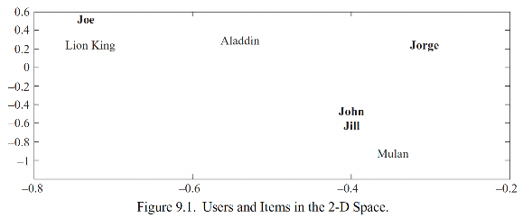
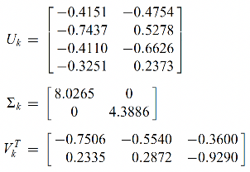
Notice how the first row in truncated U denotes John’s representation in the 2D space (since r=2). Just eyeballing this plot, we know that John is the most similar user to Jill!

Slide 29
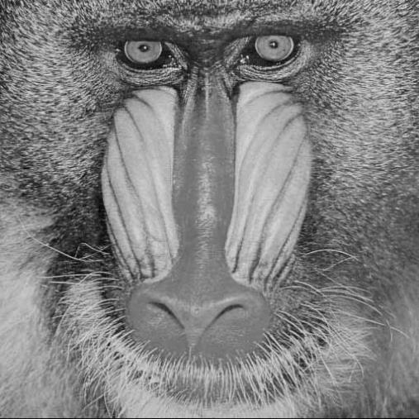
Using SVD, a 512 x 512 image (where the matrix entries represent pixel brightness) can be decomposed into superpositions of 512 single images of horizontal and vertical stripes
Stolen from https://stats.stackexchange.com/questions/177102/what-is-the-intuition-behind-svd
Notes:
https://stats.stackexchange.com/questions/177102/what-is-the-intuition-behind-svd

Slide 30

Rank-1 approximation of the original image (i.e., decomposed, truncated using r=1, and multiplied back together). Since we’ve only kept 1-dimensional features, we’ve lost too much information and cannot recreate the original matrix reasonably by multiplying back the decomposed and truncated (with r=1) matrices. Still, you can sense the darker and brighter parts of the original image being retained in this approximation!
Notes:
https://stats.stackexchange.com/questions/177102/what-is-the-intuition-behind-svd

Slide 31
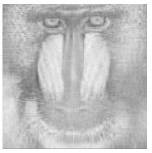
Rank-20 approximation of the original image (i.e., decomposed, truncated using r=20, and multiplied back together). Now we’ve lost less information and can visually see an approximation the original image
Notes:
https://stats.stackexchange.com/questions/177102/what-is-the-intuition-behind-svd

Slide 32
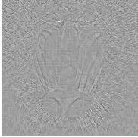
Residual image after the rank-20 approximation (i.e., the part not captured by the lower rank approximation). You can see that areas that are difficult to represent as superposition of vertical/horizontal lines (e.g., around the eyes and nose) have lost the most information. We’re essentially treating the complex parts of the image as noise and only capturing the systematic patterns in the row-column interactions of the original matrix.
Notes:
https://stats.stackexchange.com/questions/177102/what-is-the-intuition-behind-svd

Slide 33
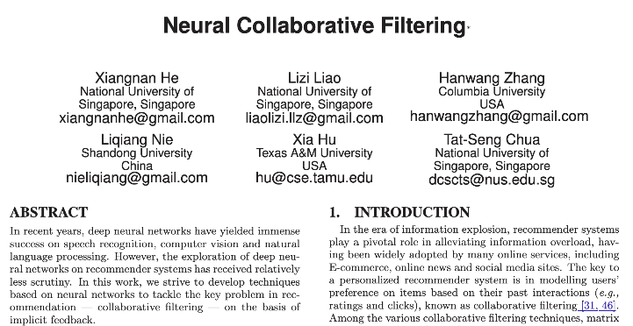

Slide 34
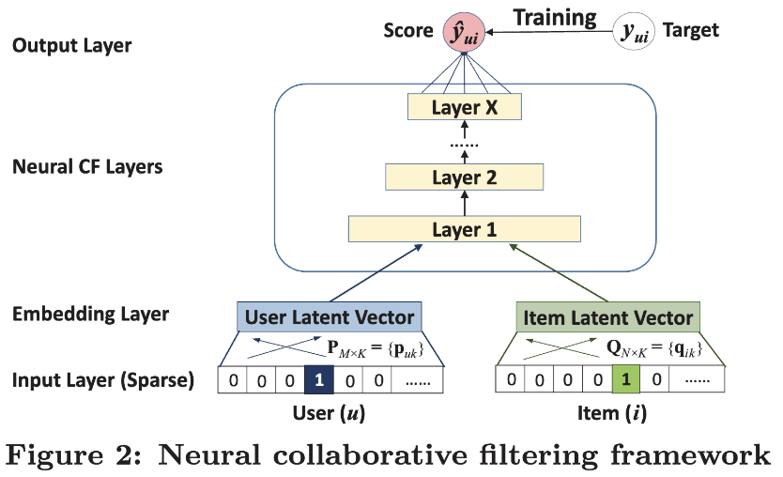

Slide 35
Reminder to self: Attendance

Slide 36
User Modeling and Recommendation Engines

Slide 37
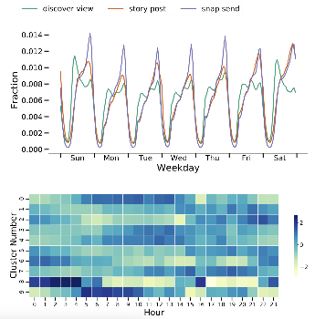
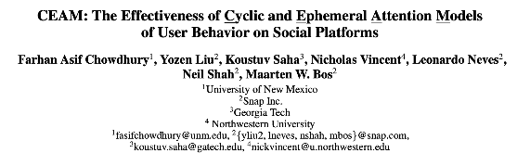
Considering Temporal Dynamics

Slide 38
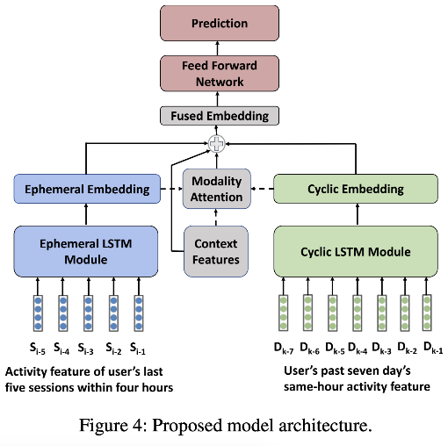

Slide 39
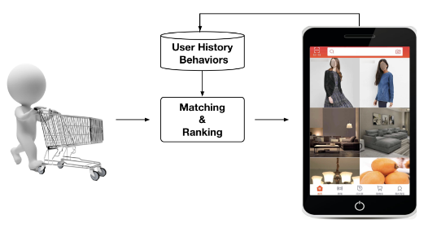
In-app vs External User Activities/Interests

Slide 40
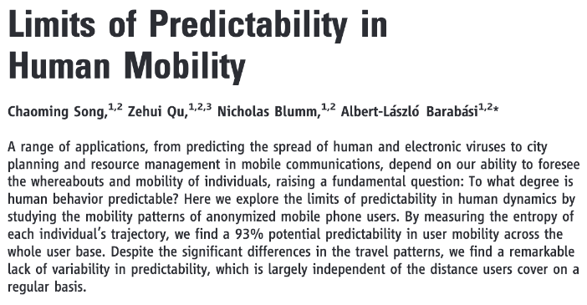

Slide 41


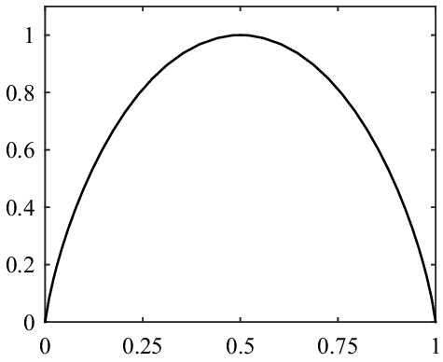
Entropy if both sides are equally likely:
= - 2* ( ½ * log₂ (½) )
= - log₂ (½)
= log₂ 2 = 1
S
p(X=heads)

Slide 42

Entropy if all 6 sides are equally likely:
= - 6* ( ⅙ * log₂ (⅙) )
= - log₂ (⅙)
= log₂ 6
S

Slide 43
Visit N locations equally, S^{rand} = log₂N

Slide 44
Visit N locations equally, S^{rand} = log₂N
Real frequencies of location visits, S^{unc} = - Σ p_{i} log₂ p_{i}

Slide 45
Visit N locations equally, S^{rand} = log₂N
Real frequencies of location visits, S^{unc} = - Σ p_{i} log₂ p_{i}
Incorporate visiting sequence, Lempel-Ziv entropy, S

Slide 46
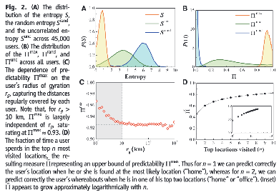
Visit N locations equally, S^{rand} = log₂N
Real frequencies of location visits, S^{unc} = - Σ p_{i} log₂ p_{i}
Incorporate visiting sequence, Lempel-Ziv entropy, S

Slide 47
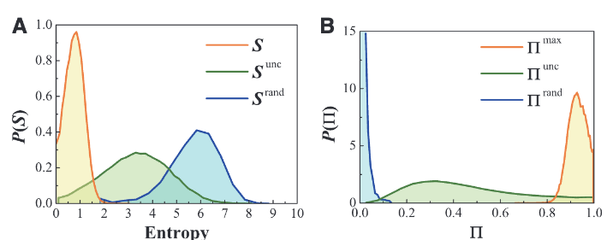
Notes:
P(Srand) peaks atSrand≈6, which indicates that,on average, each update of the user’s locationrepresents six bits per hour of new information;that is, a user who chooses randomly his or hernext location could be found on average in any of2Srand≈64 locations.

Slide 48
P(S^{rand}) peaks at S^{rand} ≈ 6, which indicates that, on average, a user who chooses randomly his or her next location can be found on average in any of 2^{S_rand} ≈ 64 locations in the next hour.

Slide 49
P(S^{unc}) peaks at S ≈ 3, which indicates that the user can be found on average in any of 2³ ≈ 8 locations in the next hour when the algorithm has access to the location visitation frequencies of each user

Slide 50
P(S) peaks at S ≈ 0.8, which indicates that the user can actually be found on average in any of 2^{0.8} ≈ 1.74 locations in the next hour (when the algorithm has access to both location visitation frequency and sequence information from the user) – less than 2 locations!! Human mobility is highly predictable.

Slide 51
In fact, a perfect algorithm can predict upto 93% of a user’s future-hour locations when the algorithm has access to location-wise visitation frequency and visitation sequence information from the user. Insane! Notice that random chance (blue curve) leads to a prediction upper limit of roughly <10%.

Slide 52

Ethics, Privacy, and Human Factors

Slide 53
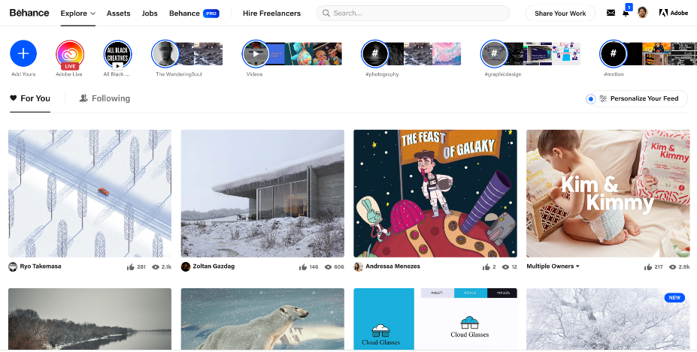

Slide 54
Questions?

Slide 55
Pop Quiz

Slide 56
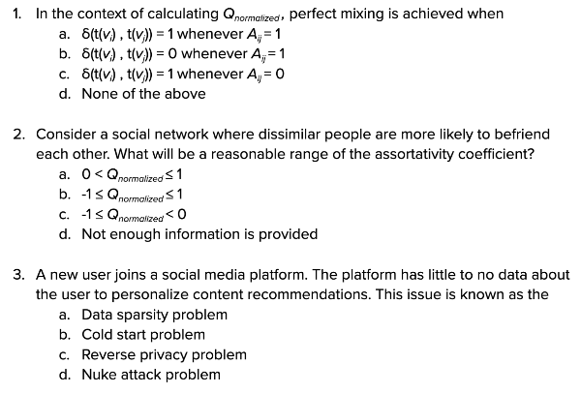

Slide 57
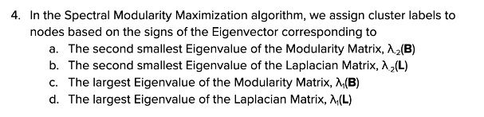
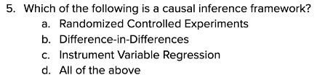

Slide 58
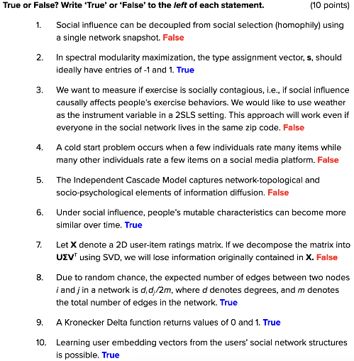

Slide 59
Group Project

Slide 60
Deliverables and Timeline
Week 15 | 4/16 | Final Presentations (Groups 1, 2, 3); slides due at midnight
 | 4/18 | Final Presentations (Groups 4, 5, 6); slides due at midnight
Test free week (4/20 - 4/26) | 4/23 | Final Presentations (Groups 7, 8, 9); slides due at midnight
 | 4/25 | Final Presentations (Groups 10, 11); slides due at midnight
Exams week (4/27 - 5/2) | 4/29 | Final Project Report due (9 am on Mon, April 29, 2024)

Slide 61
Final Presentation
 | Common grade | Individual grade
Final Presentation | 10% | 5%
Each team gets 15-18 minutes to present, each member must participate
Must include the following items:
Motivation and RQs (1% common grade weight)
Literature review (1% common grade weight)
Data (2% common grade weight)
Method (3% common grade weight)
Results (2% common grade weight)
Discussion (1% common grade weight)
Contribution of each team member

Slide 62
Final Presentation
Motivation and Research Question(s)
What did you probe and why?
State the specific research hypotheses you tested
Literature Review
Briefly summarize relevant works in literature. Explain how your work is different than theirs.
Data
Where did you acquire the data from?
How exactly did you pre-process the data?

Slide 63
Final Presentation
Method
What analysis method did you use?
What software library did you use?
Results
Did you find support for your hypotheses? Your claims should be backed by quantitative evidence.
Include figure(s) or table(s) describing your results
Discussion
Do your results agree/disagree with prior results? Do your results extend prior knowledge? Were you expecting these results? What are the limitations? What can be done next?
Contribution of each team member

Slide 64
Final Written Report
Exams week (4/27 - 5/2) | 4/29 | Final Project Report due (9 am on Mon, April 29, 2024)
 | Common grade | Individual grade
Written Report | 10% | 5%
3-4 pages + 1 page for reference and contributions of each member
IEEE conference format
Word, LaTeX, and Overleaf templates

Slide 65
Final Written Report
Abstract (0.5% common grade weight)
Motivation and RQs (1% common grade weight)
Literature review (0.5% common grade weight)
Data (2% common grade weight)
Method (3% common grade weight)
Results (2% common grade weight)
Discussion (0.5% common grade weight)
References (0.5% common grade weight)
Contribution of each team member
Provide sufficient details for someone to replicate your work. Include a link to a public Github repository with all your code.

Slide 66
Thank you!

